Slide 1
Galaxy Buds2 Pro
Localization Guide
- P6 Standard feature HTML
Ver 1.0 / Update Feb, 2024

Slide 2
Adaptation Guideline
Assets have been approved by the HQ legal Office. However, local market MUST check with your local legal team for clearance prior to going to market.
For adaptation of the content, each local office is responsible for translating, subtitling, captioning and uploading of the distributed assets.
Please make sure to follow the guidelines and usage terms when utilizing the assets.
URL structure and naming must not be edited by local. Local language is not allowed.

Slide 3
3. Localization Guideline

Slide 4
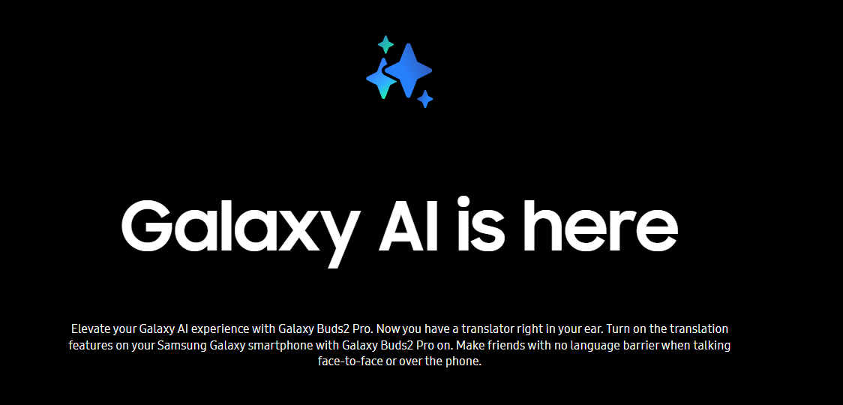
Localization Guideline
Headline
Logo Img url & Title & Description text change
1
index_pim.html
<div class="sc-buds-ai__headline">
<div class="sc-buds-ai__logo">
<img
class="sc-buds-ai__logo__image"
src="https://images.samsung.com/is/image/samsung/assets/[site-code]/mobile/2022-2h/galaxy-buds2/galaxy-buds2-ai-logo_v2.png"
/>
</div>
<h2
class="sc-buds-ai__title"
id="tabTitleId_01"
data-font-size-pc="50"
data-font-size-mo="32"
>
Galaxy AI is here
</h2>
<p
class="sc-buds-ai__description"
data-font-size-pc="18"
data-font-size-mo="30"
>
Elevate your Galaxy AI experience with Galaxy Buds2 Pro. Now you have a
translator right in your ear. Turn on the translation features on your
Samsung Galaxy smartphone with Galaxy Buds2 Pro on. Make friends with no
language barrier when talking face-to-face or over the phone.
</p>
</div>
1
3

